Slide 1
Prompt-Based Learning
Natural Language Processing

Slide 2
Suggested Readings
Language Models are Few-Shot Learners (NIPS 2020)
Calibrate Before Use: Improving Few-Shot Performance of Language Models (ICML 2021)
Prefix-Tuning: Optimizing Continuous Prompts for Generation (ACL 2021)
The Power of Scale for Parameter-Efficient Prompt Tuning (EMNLP 2021)

Slide 3
Large models
BERT-base: 110M params, 12-layer Transformer
BERT-large: 340M params, 24-layer Transformer
GPT-3: 175B params, 96-layer Transformer
Chatgpt: 175B params, 96-layer Transformer

Slide 4
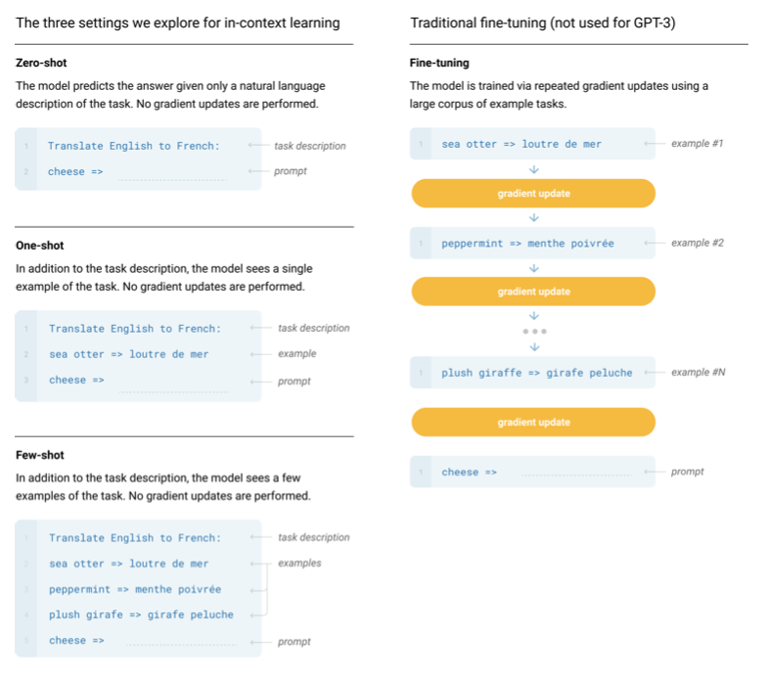
GPT3 proposes prompt-based learning
No fine-tuning, i,e., no gradient updates
Just take the pretrained LM and give it the prefix
Actually, it is quite strange how it works
Source: Language Models are Few-Shot Learners (NIPS 2020)

Slide 5
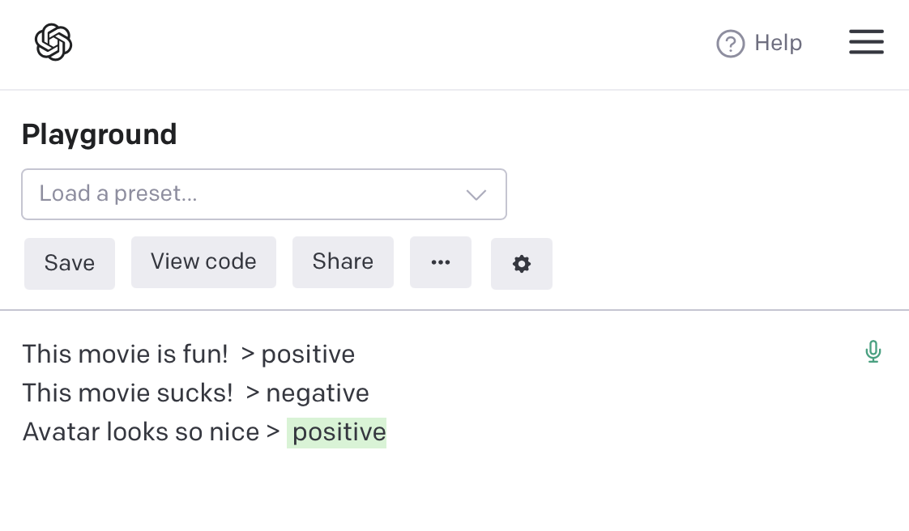
Demo
https://beta.openai.com/playground

Slide 6
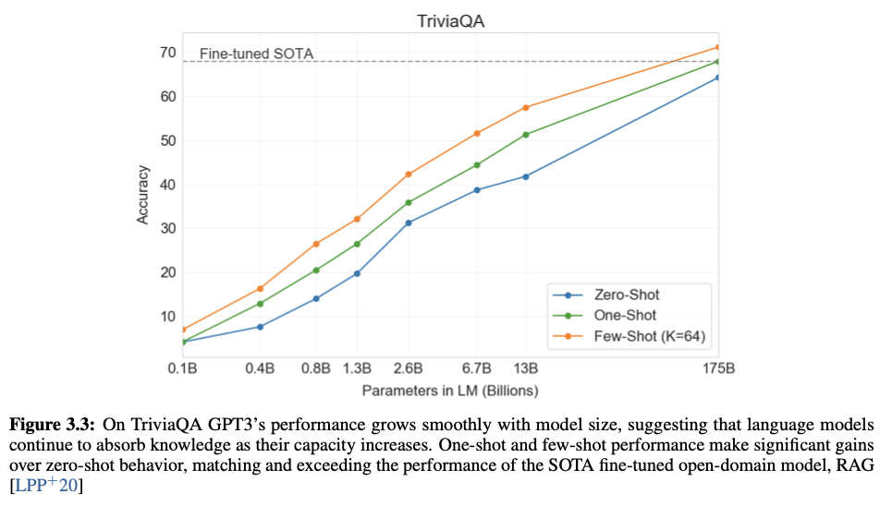
Finetuning vs. prompt-based: Trivia QA
Source: Language Models are Few-Shot Learners (NIPS 2020)

Slide 7
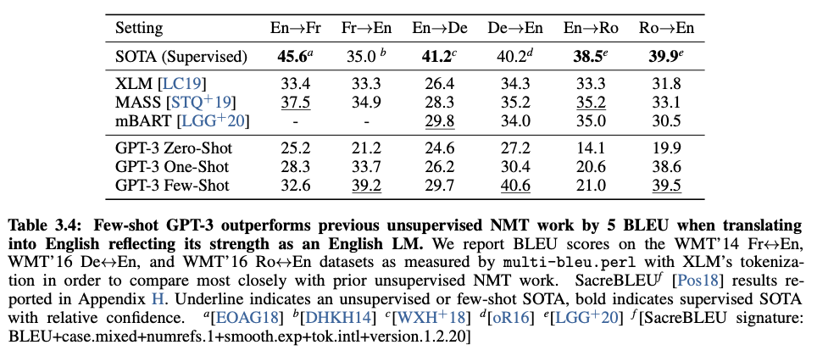
Finetuning vs. prompt-based: MT
Source: Language Models are Few-Shot Learners (NIPS 2020)

Slide 8
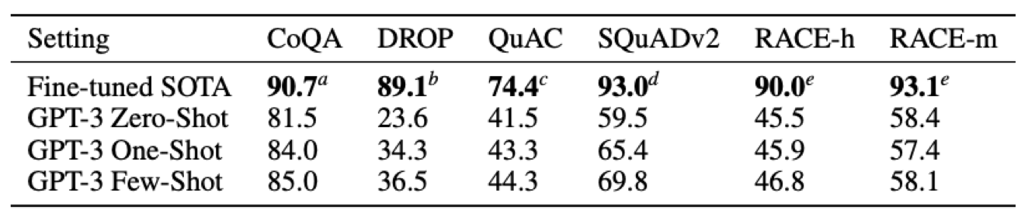
Finetuning vs. prompt-based: Reading Comprehension
Source: Language Models are Few-Shot Learners (NIPS 2020)

Slide 9
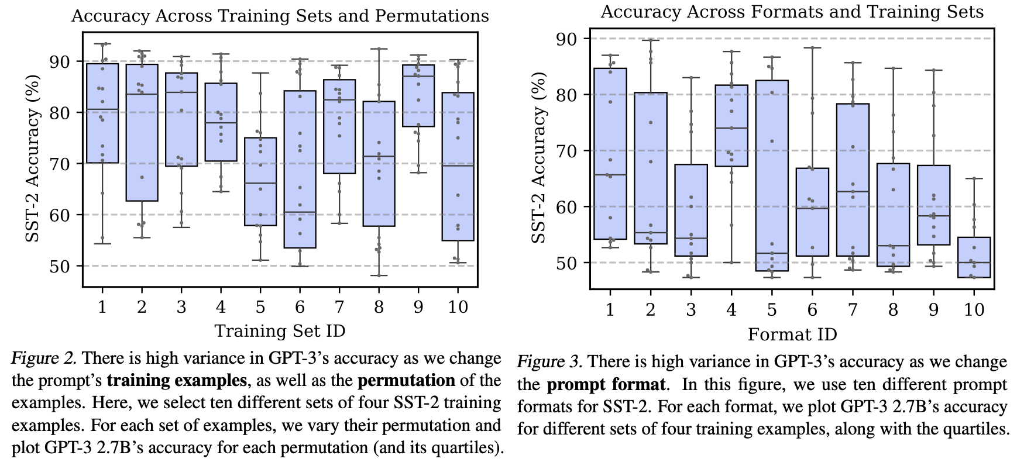
So..what’s next
Seems promising
Designing manual prompts is difficult
we don’t quite understand how internally it works
Prompts are very sensitive
Why so much variance?
Label bias in the prompts
Repeat answer near the end of the prompts
Tend to answer based on distribution of tokens used in pretraining
Calibrate Before Use: Improving Few-Shot Performance of Language Models (ICML 2021)

Slide 10
Many methods have been proposed

Slide 11
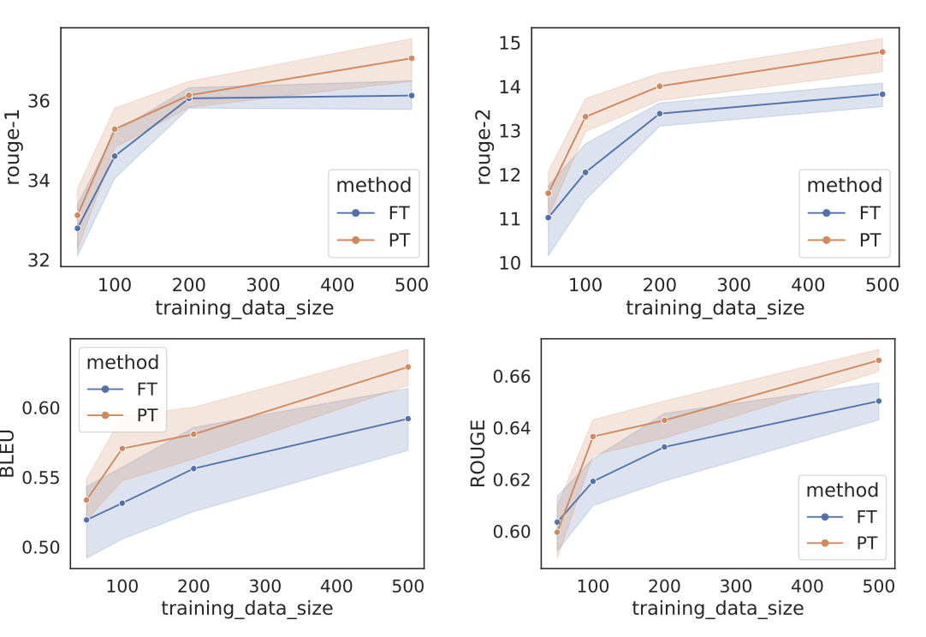
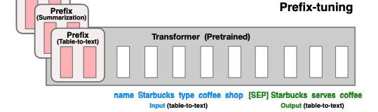
Prefix tuning
freezes the model parameters and back- propagates the error during tuning to prefix activations prepended to each layer in the encoder stack, including the input layer.
Prefix-Tuning: Optimizing Continuous Prompts for Generation (ACL 2021)

Slide 12
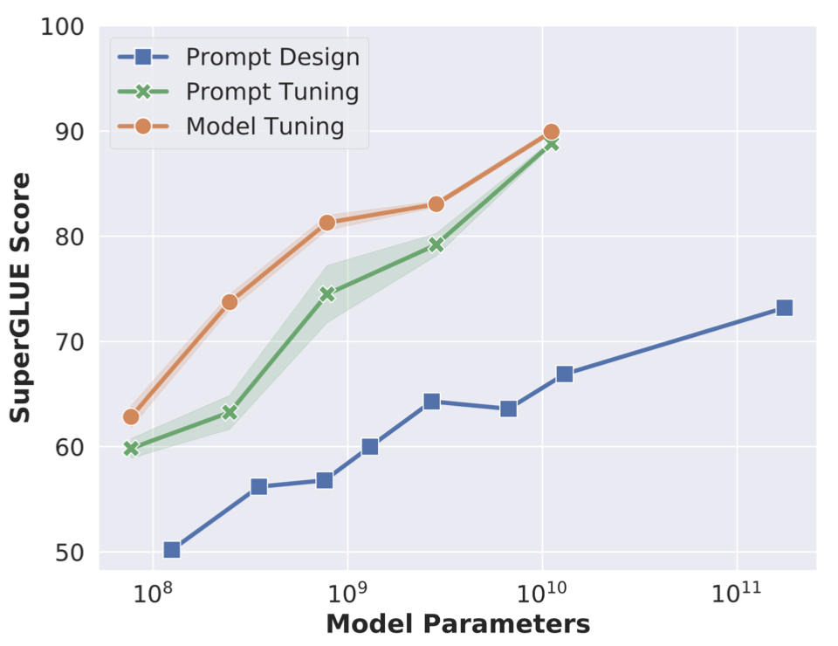
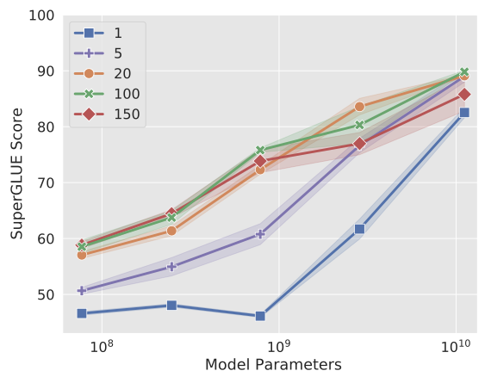
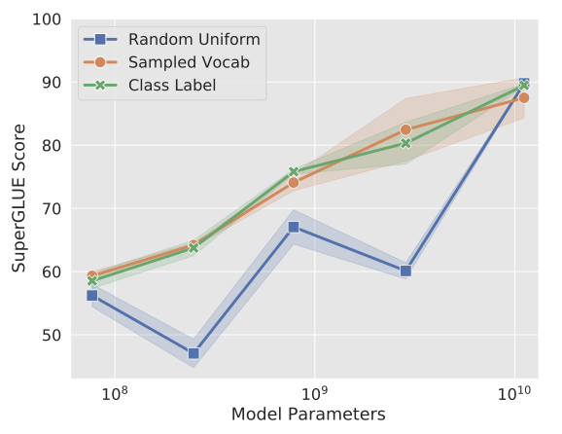
Prompt tuning
Basically the same, but ONLY change the input layer
Prompt tuning becomes more competitive with scale
For large model, even one token is good? Strange!
Using sampled vocab or class label embeddings seems more stable
The Power of Scale for Parameter-Efficient Prompt Tuning (EMNLP 2021)

Slide 13
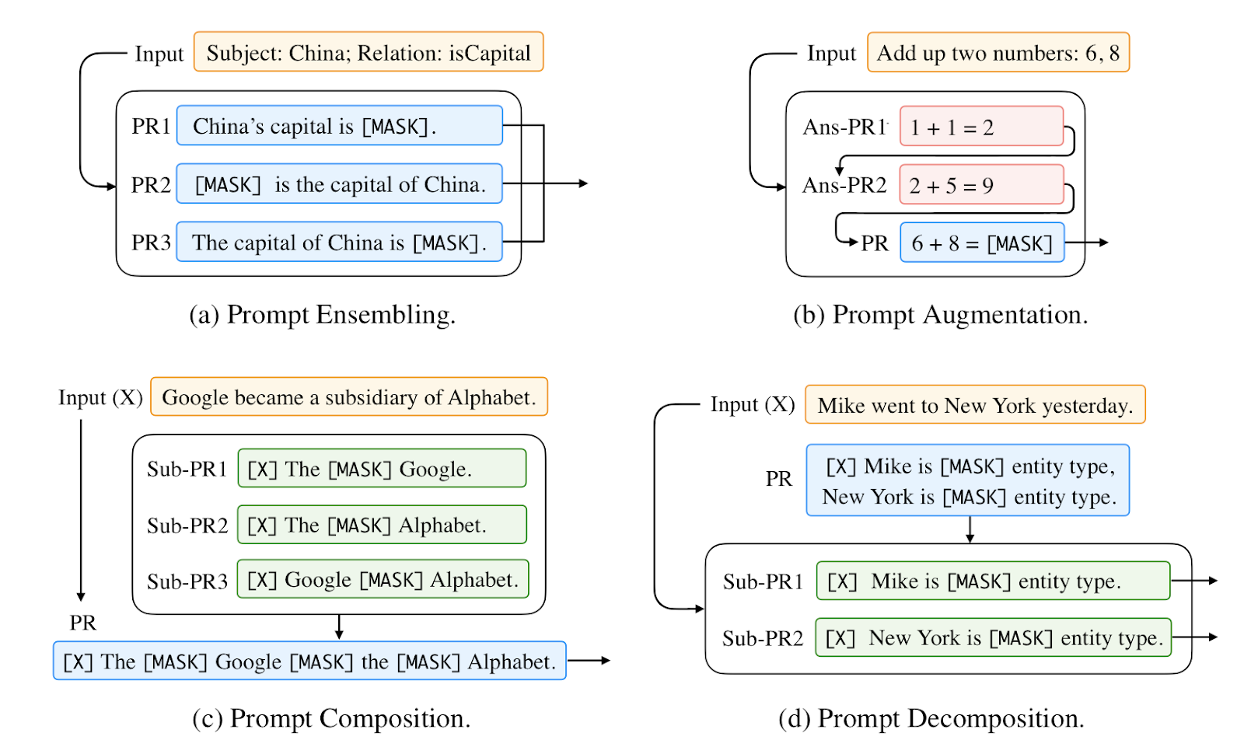
Prompt Ensemble
Uses multiple unanswered prompts for an input at inference time to make predictions
Typical methods :
Uniform averaging
Weighted averaging
Majority voting
Advantages : Alleviate the cost of prompt engineering

Slide 14
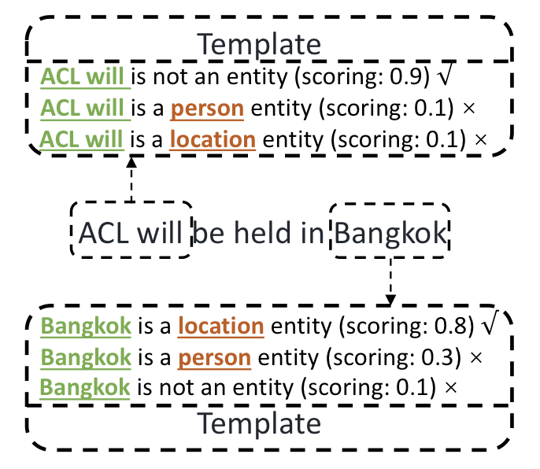
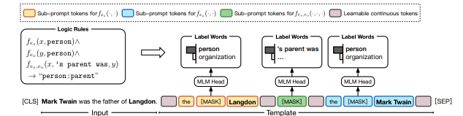
Prompt Demonstration
Using multiple sub-prompts, each for one subtask
Multiple predictions should be performed for one sample
Ref: https://arxiv.org/abs/2105.11259, https://arxiv.org/abs/2001.07676

Slide 15
Prompt searching via gradient descent
Using multiple sub-prompts, each for one subtask
Multiple predictions should be performed for one sample
Ref: https://arxiv.org/abs/2105.11259, https://arxiv.org/abs/2001.07676

